Slide 1

Page Factory in Selenium

Slide 2
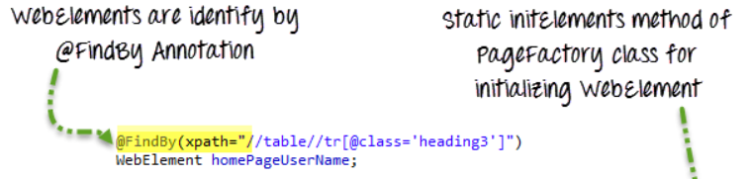

Introduction
The PageFactory in Selenium is an extension to the Page Object design pattern.
PageFactory is used to initialize the elements of the Page Object or instantiate the Page Objects itself
PageFactory is used to initialize elements of a Page class without having to use ‘FindElement’ or ‘FindElements’.
Annotations can be used to supply descriptive names of target objects to improve code readability.
Page Factory is one way of implementing the ‘Page Object Model’.

Slide 3
Difference between POM and Page Factory
Page Object is a class that represents a web page and hold the functionality and members. Page Factory is a way to initialize the web elements you want to interact with within the page object when you create an instance of it.

Slide 4
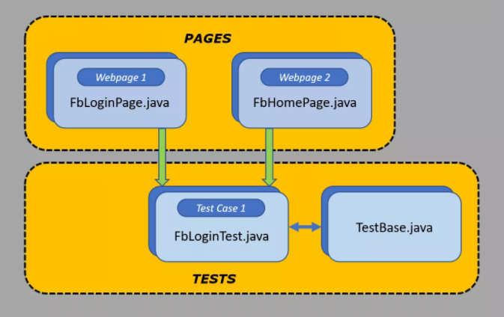
Procedure to implement Page Factory
Step 1) Creating TestBase class. Here we create an object of WebDriver, maximize browser, implementing waits, launching URL etc.
Now see the code here:- TestBase.java (BASE CLASS)
package tests;
import java.io.IOException;
import java.util.concurrent.TimeUnit;
import org.openqa.selenium.WebDriver;
import org.openqa.selenium.chrome.ChromeDriver;
import org.testng.annotations.AfterSuite;
import org.testng.annotations.BeforeSuite;
public class TestBase {
public static WebDriver driver = null;
@BeforeSuite
public void initialize() throws IOException{
System.setProperty("webdriver.chrome.driver", System.getProperty("user.dir")+"\\src\\test\\java\\drivers\\chromedriver.exe");
driver = new ChromeDriver();

Slide 5
Step 2) Creating classes for each page (Facebook Login Page, Facebook Home Page) to hold element locators and their methods.
Now see the code in next slide:- FBHomePage.java (Webpage 1)
//To maximize browser
driver.manage().window().maximize();
//Implicit wait
driver.manage().timeouts().implicitlyWait(20, TimeUnit.SECONDS);
//To open facebook
driver.get("https://www.facebook.com");
}
@AfterSuite
//Test cleanup
public void TeardownTest()
{
TestBase.driver.quit();
}
}

Slide 6
package pages;
import org.openqa.selenium.WebDriver;
import org.openqa.selenium.WebElement;
import org.openqa.selenium.support.FindBy;
import org.openqa.selenium.support.How;
public class FbHomePage {
WebDriver driver;
public FbHomePage(WebDriver driver){
this.driver=driver;
}
//Using FindBy for locating elements
@FindBy(how=How.XPATH, using="//div[text()='Account Settings']") WebElement profileDropdown;
@FindBy(how=How.XPATH, using="//text()[.='Log Out']/ancestor::span[1]") WebElement logoutLink;
@FindBy(how=How.XPATH, using="///div[text()='Good afternoon, SoftwareTesting!']") WebElement loggedInUserNameText;
// Defining all the user actions (Methods) that can be performed in the Facebook home page
// This method to click on Profile Dropdown
public void clickOnProfileDropdown(){
profileDropdown.click();}

Slide 7
Now see the code here:- FBLoginPage.java (Webpage 2)
// This method to click on Logout link
public void clickOnLogoutLink(){
logoutLink.click();
}
// This method to verify LoggedIn Username Text
public String verifyLoggedInUserNameText(){
String userName = loggedInUserNameText.getText();
return userName;
} }
package pages;
import org.openqa.selenium.WebDriver;
import org.openqa.selenium.WebElement;
import org.openqa.selenium.support.FindBy;
import org.openqa.selenium.support.How;
public class FbLoginPage {
WebDriver driver;
public FbLoginPage(WebDriver driver){
this.driver=driver;
}

Slide 8
//Using FindBy for locating elements
@FindBy(how=How.XPATH, using="//input[@type='email'][@name='email']") WebElement emailTextBox;
@FindBy(how=How.XPATH, using="//input[@type='password'][@name='pass']") WebElement passwordTextBox;
@FindBy(how=How.XPATH, using="//input[@type='submit'][@id='u_0_5']") WebElement signinButton;
// Defining all the user actions (Methods) that can be performed in the Facebook home page
// This method is to set Email in the email text box
public void setEmail(String strEmail){
emailTextBox.sendKeys(strEmail);
}
// This method is to set Password in the password text box
public void setPassword(String strPassword){
passwordTextBox.sendKeys(strPassword);
}
// This method is to click on Login Button
public void clickOnLoginButton(){
signinButton.click();
} }

Slide 9
Step 3) Creating Test (FBLoginTest) based on Previous slides.
Now see the code here:- FBLoginTest.java (Test Case 1)
package tests;
import org.openqa.selenium.support.PageFactory;
import org.testng.annotations.Test;
import pages.FbHomePage;
import pages.FbLoginPage;
public class FbLoginTest extends TestBase{
@Test
public void init() throws Exception{
FbLoginPage loginpage = PageFactory.initElements(driver, FbLoginPage.class);
loginpage.setEmail("rajkumarsmonline@gmail.com");
loginpage.setPassword("raj123456");
loginpage.clickOnLoginButton();
FbHomePage homepage = PageFactory.initElements(driver, FbHomePage.class);
homepage.clickOnProfileDropdown();
homepage.verifyLoggedInUserNameText();
homepage.clickOnLogoutLink();
}
}

Slide 10
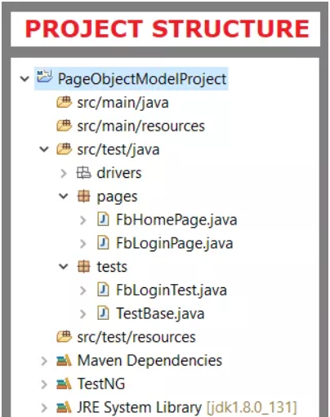
Step 4)Creating testng.xml file
Now see Project explorer window look like this:-
<?xml version="1.0" encoding="UTF-8"?>
<!DOCTYPE suite SYSTEM "http://testng.org/testng-1.0.dtd">
<suite name="Everjobs Suite">
<test name="Page Object Model Project">
<classes>
<class name="tests.TestBase" />
<class name="tests.FbLoginTest" />
</classes>
</test>
</suite> <!-- Suite -->

Slide 11
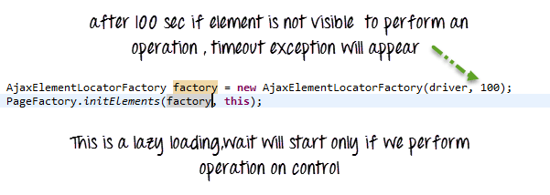
AjaxElementLocatorFactory
One of the key advantages of using Page Factory pattern is AjaxElementLocatorFactory Class.
It is working on lazy loading concept i.e. a timeout for a WebElement will be assigned to the Object page class with the help of AjaxElementLocatorFactory .
When an operation is performed on an element the wait for its visibility starts from that moment only. If the element is not found in the given time interval,test case execution will throw 'NoSuchElementException' exception.

Slide 12
Covered Till Now
Page Factory is an optimized way to create object repository in POM concept.
AjaxElementLocatorFactory is a lazy load concept in Page Factory pattern to identify WebElements only when they are used in any operation.

Slide 13
Thanks

